Slide 1
ACCESS Centers
Submitting Documentation, Intake Form, Requesting Accommodations

Slide 2
ACCESS Center Contacts
Prepared January 2022
Richard J. Daley College
Saul Santana, Director
ssantana24@ccc.edu
Harold Washington College
Nicolette Radford, Director
nradford@ccc.edu
Kennedy-King College
Tanya Cox, Director
tcox11@ccc.edu
Malcolm X College
Nitoya Brown, Director
nbrown163@ccc.edu
Olive-Harvey College
Patrice Henderson, Director
phenerson10@ccc.edu
Harry S. Truman College
Lauren Daley, Director
ldaley@ccc.edu
Wilbur Wright College
Sophie Levandoski, Director
slevandoski@ccc.edu
If you experience technical difficulties using the system, please email the Help Desk at cohelpdesk@ccc.edu.

Slide 3
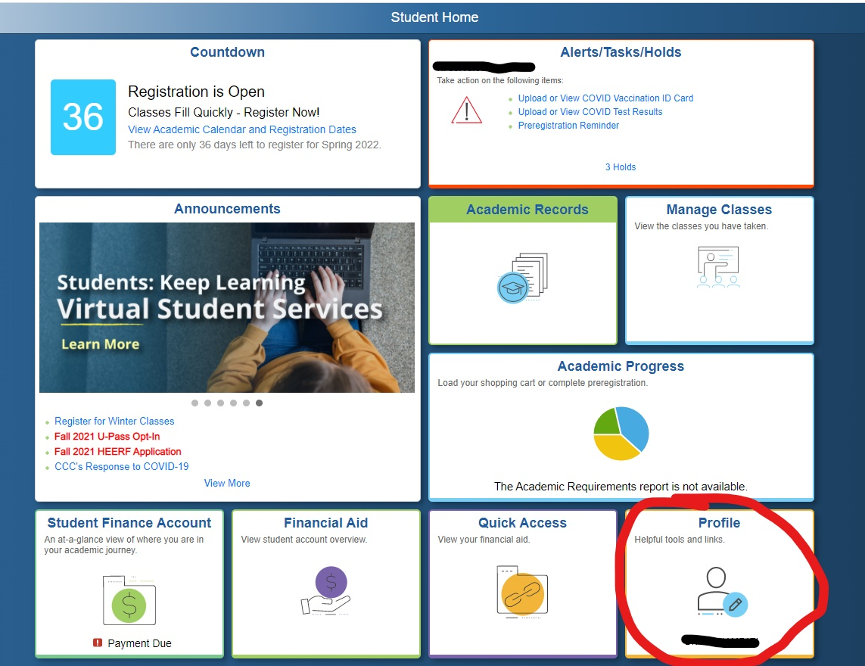
Student Portal
Visit www.my.ccc.edu
Log in using your CCC credentials
Click on your profile in the lower right hand corner

Slide 4
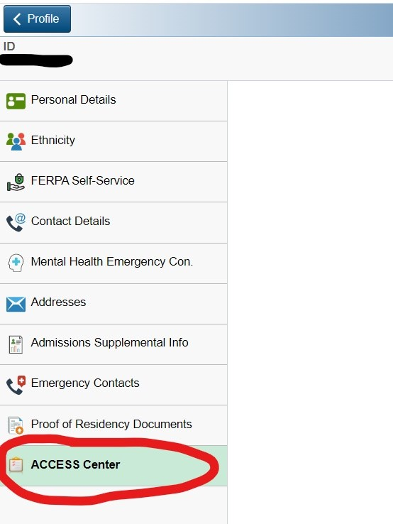
ACESS Center Dashboard
Click on ACCESS Center at the bottom of the list
This will take you to the ACCESS Center Portal

Slide 5
STOP!
If you have never used ACCESS Center services before, continue to the next slide.
If you are already registered with the ACCESS Center and have used services before, skip to Slide 12 – Requesting Class Accommodations

Slide 6
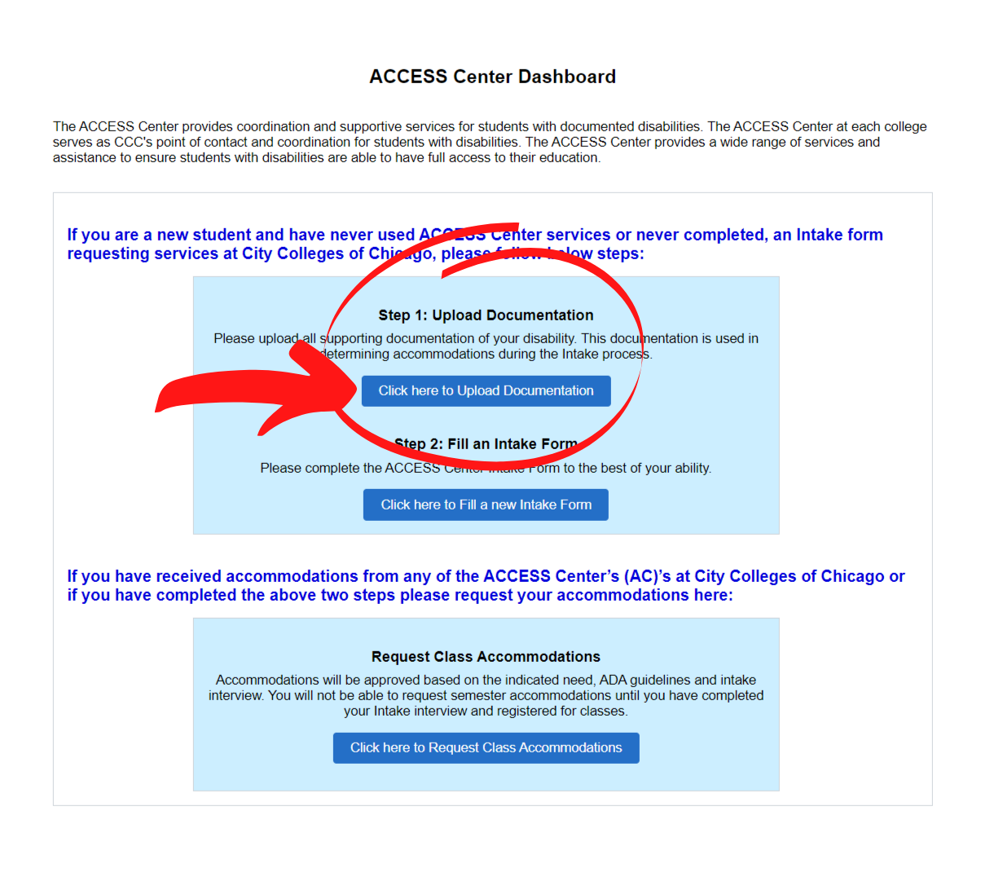
ACCESS Center Dashboard
Step 1: Upload Documentation
In the ACCESS Center Dashboard, you can submit your supporting documentation, fill out your intake form, request class accommodations, view/sign all relevant agreements, and receive your letters of accommodation!
The first step is uploading documentation.
Click the button “Click here to Upload Documentation” and proceed to the next slide.

Slide 7
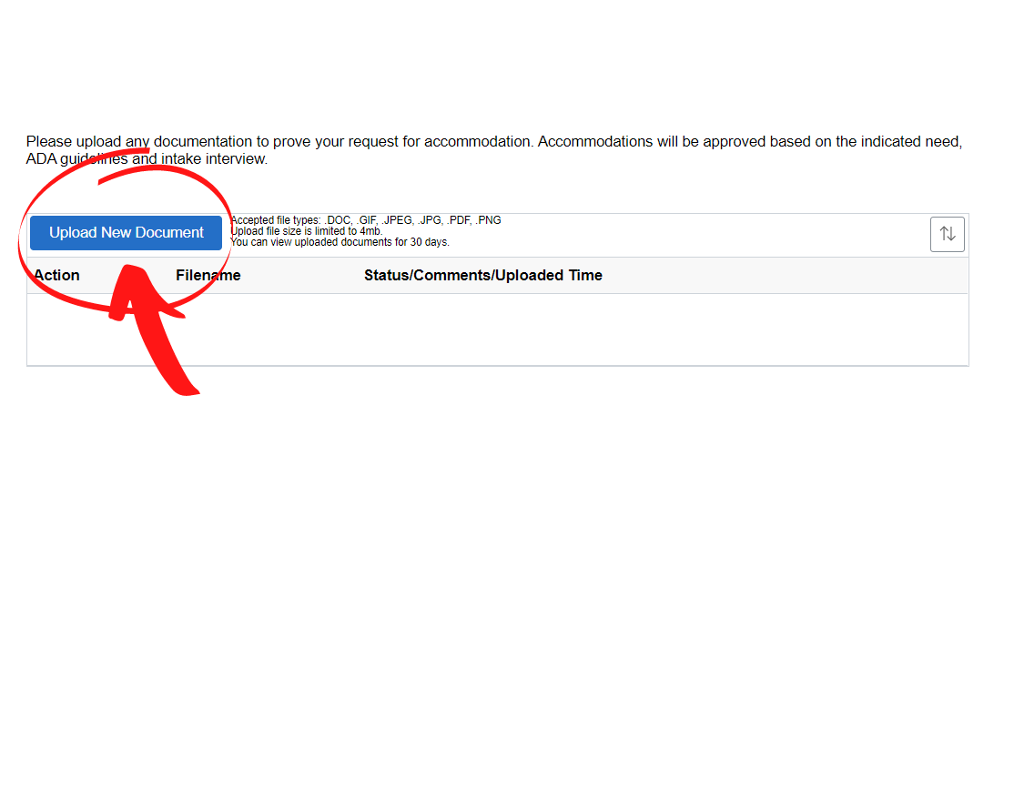
Step 1: Upload Documentation
Click “Upload New Document”
Accepted file types are .doc, .gif, .jpeg, .pdf, .png
Upload all supporting documentation of your disability
  A letter from your diagnosing physician
  An audiogram
  Diagnostic testing results indicating diagnosis of your disability
  IEP/504 Plan complete with testing battery
  Etc.
This information remains confidential and no one outside of the ACCESS Center will have access to your documentation
If you are unsure if your documentation is appropriate, reach out to the ACCESS Center of your home campus.
Step 1 continues on the next slide.

Slide 8
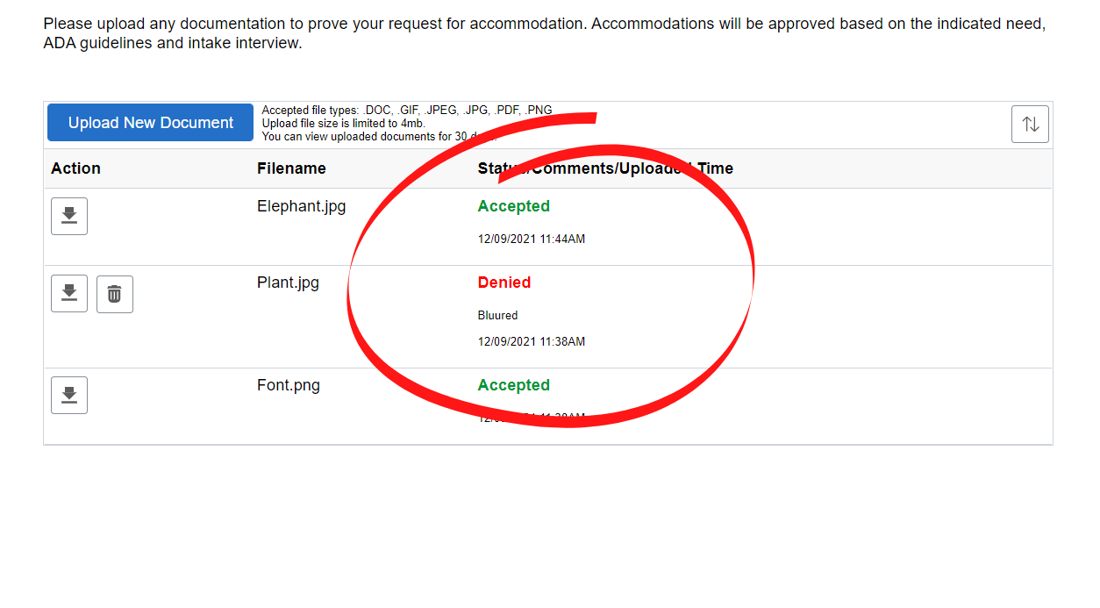
Step 1: Upload Documentation
After you upload all relevant documentation, ACCESS Center Directors will review your submissions.
In the portal, you can see if your documentation has been accepted or denied.
If you receive a denial, you will be able to see why your document was denied.
Reasons for denial could be:
  Unclear image
  Unrelated documentation
  Etc.
If your document is denied, and you are unsure of the reason, please contact the ACCESS Center at your home campus.

Slide 9
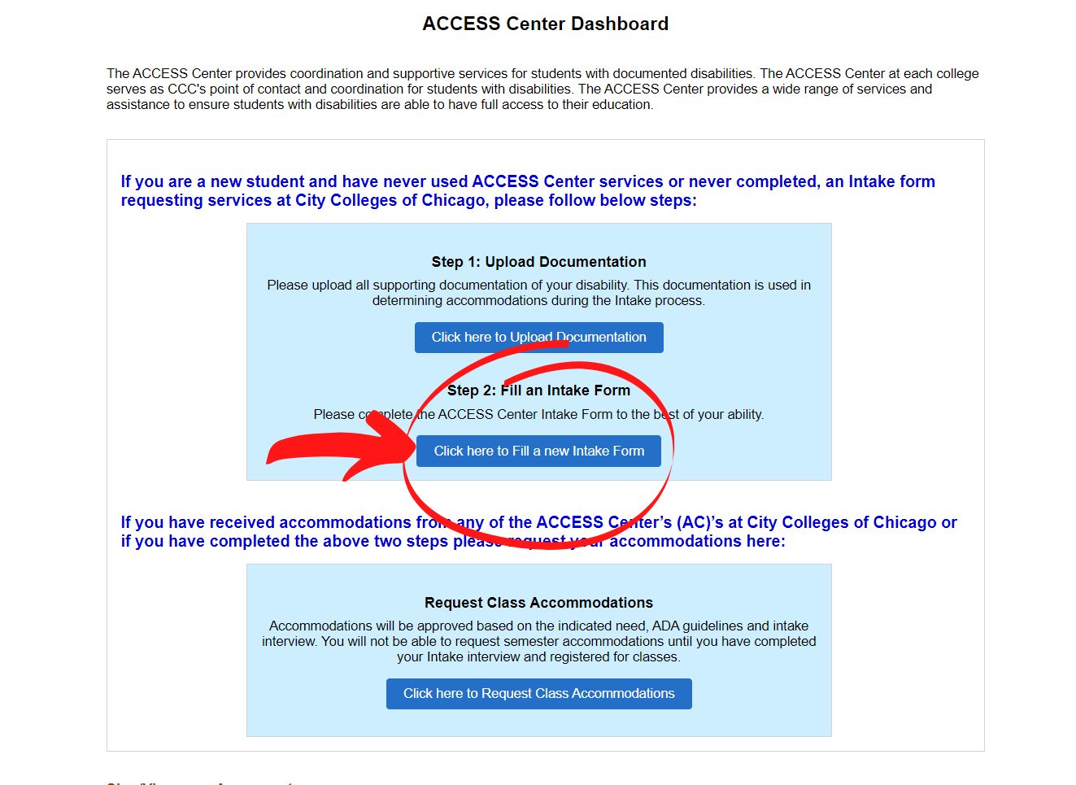
ACCESS Center Dashboard
Step 2: Fill an Intake Form
After you submit your supporting documentation, return to the ACCESS Center Dashboard.
Under Step 2: Fill an Intake Form, click the button “Click here to fill a new Intake Form” and proceed to the next slide.

Slide 10
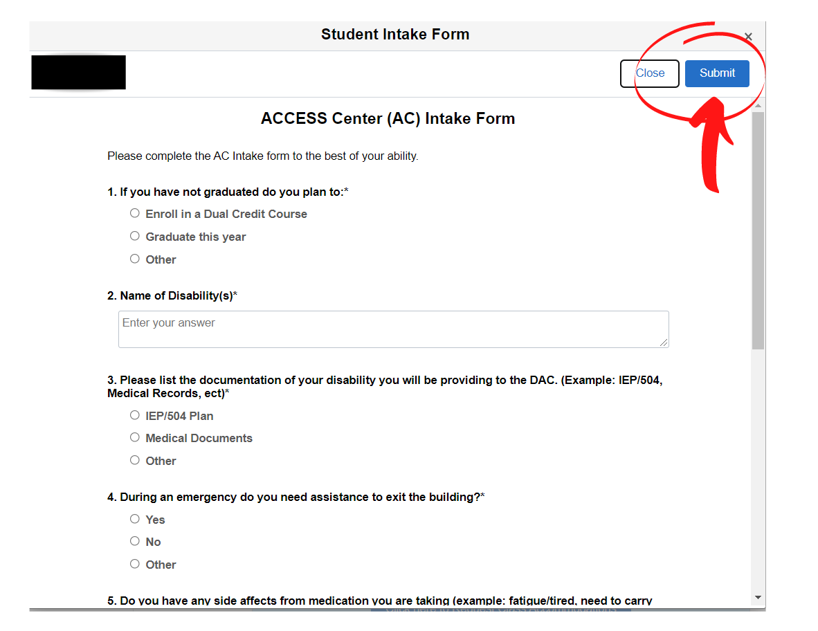
Step 2: Intake Form
Complete the Intake Form as thoroughly as you can.
The information you share helps Directors work with you to determine reasonable accommodations.
There is a mix of multiple choice and short response questions. Answer every question.
When you are done, click “submit” in the top right corner.
The Director of your home campus will contact you to schedule an intake interview after you submit your answers.

Slide 11
Intake Interview
During your intake, the Director will use your submitted documentation and your Intake Form answers to work with you on establishing your accommodations.
This is an interactive process, and your input is valuable.
Come ready to discuss your educational experiences and how your disability has affected your learning outcomes.

Slide 12
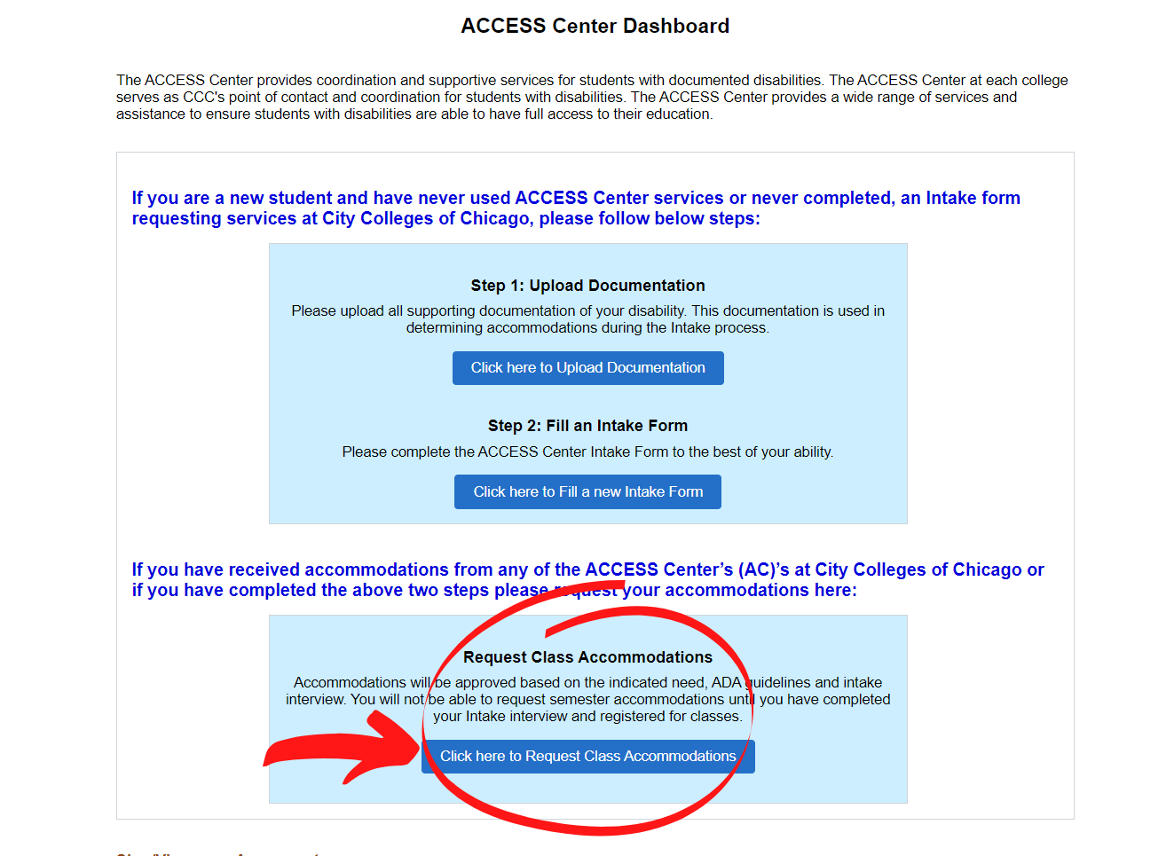
ACCESS Center Dashboard
Step 3: Request Class Accommodations
After you have completed your intake interview and registered for classes, you will be able to request class accommodations.
Click on the button “Click here to Request Class Accommodations” and proceed to the next slide.

Slide 13
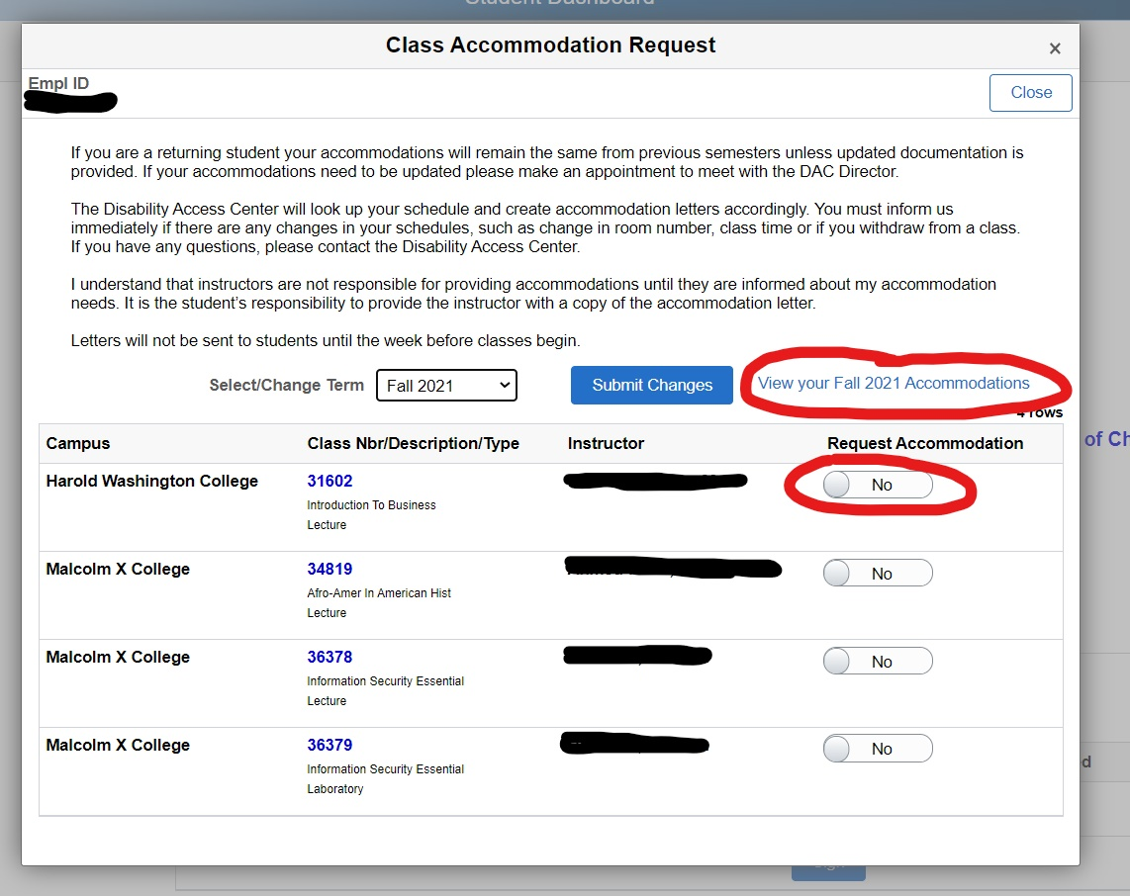
Step 3: Requesting Accommodations
You can request accommodations for your courses only after you have registered. Meet with your advisor and enroll in your courses before trying to request accommodations.
Your class schedule will load here in this window.
Check on your accommodations any time by clicking “View your accommodations”
For any class that you want to receive accommodations for, toggle the “no” to “yes” and click “Submit Changes.”

Slide 14
Step 3: Requesting Accommodations - LOAs
After you request your semester accommodations, your ACCESS Center Directors will take the appropriate next steps.
  If you are taking classes at a campus other than your home campus, and you have never worked with the Director at that campus, they may reach out to determine if you need anything outside of your already approved accommodations.
Directors will view your request, and after they have review and approved your accommodations for that semester, your Letter of Accommodation will be automatically emailed to you.
It is your responsibility to forward that letter to your instructor for that class.
If you don’t receive your letter more than three days after submitting your request for accommodations, reach out to the ACCESS Center corresponding to inquire.

Slide 15
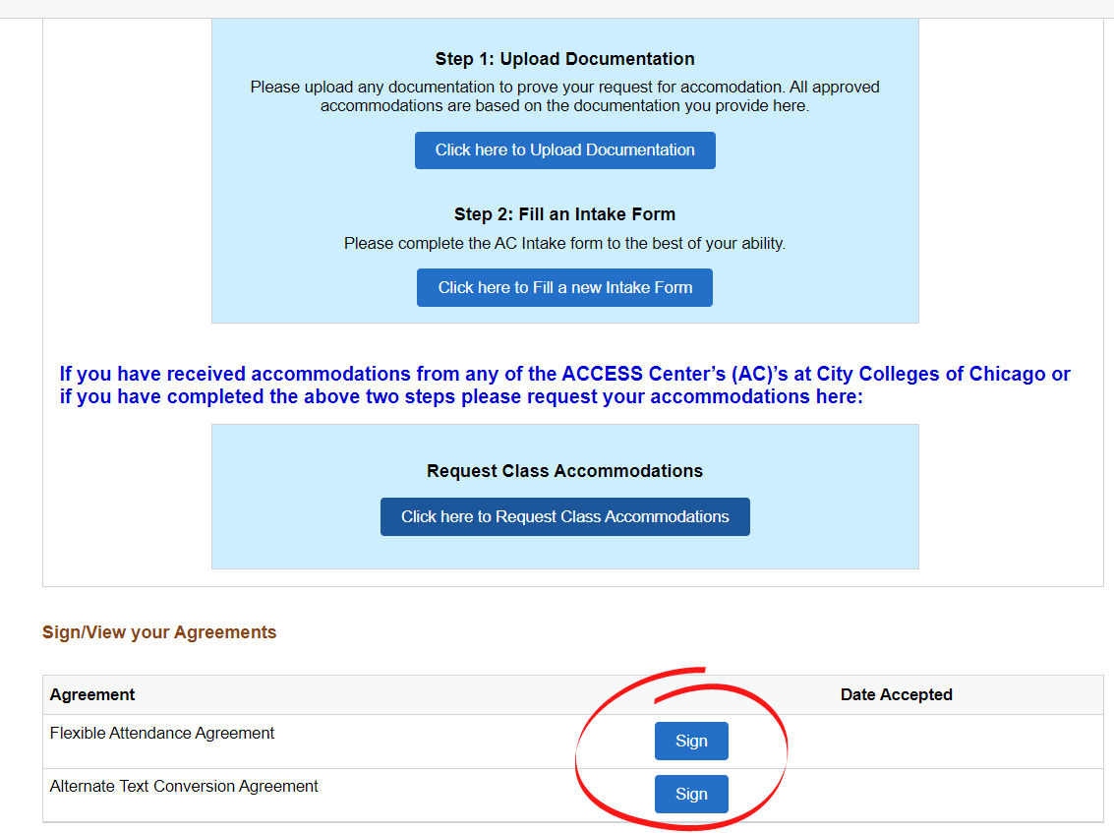
ACCESS Center Dashboard
Step 4: Service Agreements
Service agreements are required for some accommodations.
These agreements are NOT contracts.
The agreements outline the policies for that accommodation. Not all accommodations come with an agreement, but some examples are:
  Notetakers, Sign Language Interpreters, MedFlex, Text Conversion, etc.
After you are approved for accommodations, the necessary agreements will appear on your dashboard.
Click “Sign” to open the agreement and sign it. You can review these after you sign as well. They will stay on your dashboard.

Slide 16
Questions?
Contact your home campus’ ACCESS Center. More information can be found here: ACCESS Centers
For contact information, see the next slide.

Slide 17
ACCESS Center Contacts
Prepared January 2022
Richard J. Daley College
Saul Santana, Director
ssantana24@ccc.edu
Harold Washington College
Nicolette Radford, Director
nradford@ccc.edu
Kennedy-King College
Tanya Cox, Director
tcox11@ccc.edu
Malcolm X College
Nitoya Brown, Director
nbrown163@ccc.edu
Olive-Harvey College
Patrice Henderson, Director
phenerson10@ccc.edu
Harry S. Truman College
Lauren Daley, Director
ldaley@ccc.edu
Wilbur Wright College
Sophie Levandoski, Director
slevandoski@ccc.edu
If you experience technical difficulties using the system, please email the Help Desk at cohelpdesk@ccc.edu.

