Slide 1
Online Learning New Student Orientation

Slide 2
Questions Answered By This Orientation​
Overview
What to expect when taking an Online course​
What to expect when taking an Online Live/Zoom course​
What are the technology requirement​
What basic computer skills are needed​
How and when to log into my online course(s)​
How to participate in my course and turn in work​
Where to purchase my textbooks​
What student support services are available​
Who to contact with questions

Slide 3
What should I expect when taking an Online Course?​
Expectations
100% online. Students will not be in a physical classroom.
Course content and assignments are available on Brightspace ​(Learning Management System)
Certain level of independent learning​
Requires self-motivation, discipline and great time management skills​
Feedback from your instructor occurs within 24-48hrs​
Frequent participation is key to success

Slide 4
Myths about online courses
Expectations
Myths​ | Reality
Online courses are “easier” than face-to-face courses​ | Could be harder depending on your skill level​ Usually involves more commitment than face-to-face courses​
Online courses are self-paced​ | Not exactly, your syllabus guides you on when you should submit assignments and participate​
Online courses are not as engaging as face-to-face courses​ | Just as engaging as face-to-face courses when: ​ Using interactive conference tools and participating in discussion boards​ Frequent communication with peers​

Slide 5
Time Commitment for Online Courses
Expectations
Expect to spend approximately 3-4 hours per credit hour per week
Example: A three credit hour course may require about 9-12hrs of work per week
We recommend that you create a weekly schedule that includes your online course work
KEEP​
CALM​
AND​
STUDY​
ON​

Slide 6

What should I expect in an Online Live/Zoom Course ?
Expectations
Synchronous (live) lectures and self-paced activities that involves instructor to student and student to student interactions through technology - Zoom. ​
Set meeting times:
  Times are listed during registration ​
  Students are required to attend live meetings
Navigation and presentation of each course varies depending on the instructor.​
This Photo by Unknown Author is licensed under CC BY-NC

Slide 7

Academic Integrity and Dishonesty
Plagiarism
Do your best to submit original work and paraphrase. Always document your sources.
Please refer to the CCC student policy Manual – Article 8.17 for Academic Integrity and Dishonesty
Turn-it-In plagiarism software may be used by instructors to support students in avoiding plagiarism

Slide 8
Computer Technology Requirements
Technology
Access to a computer:
  Personal
  CCC libraries or computer labs
  Borrow through CCC loaner laptop program
PC or MAC can be used*
Mobile devices*
Internet Access
Latest browser and plug-in software
GOLDEN RULE: Always have a back up plan!
Apps are available for Android and iOS devices (PULSE)
MAC computers may not be compatible with some Computer Science courses
All course work can NOT be completed with a Mobile Device

Slide 9

Basic Computer Skills
Technology
Browsing the Internet
Emailing
Word Processing
Uploading, Downloading, Saving and Retrieving Files
Installing Software
This Photo by Unknown Author is licensed under CC BY-SA-NC

Slide 10
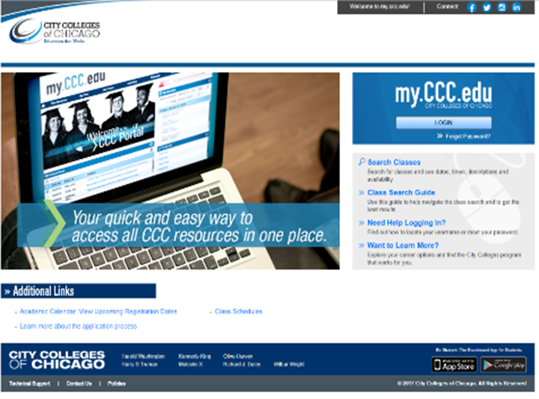
Logging into your Online or Online/Live course
Being Active
Option 1
Go to CCC Student Portal website using your ccc username and password.
For help with the student portal, refer to the portal help guides
This Photo by Unknown Author is licensed under CC BY-SA-NC

Slide 11
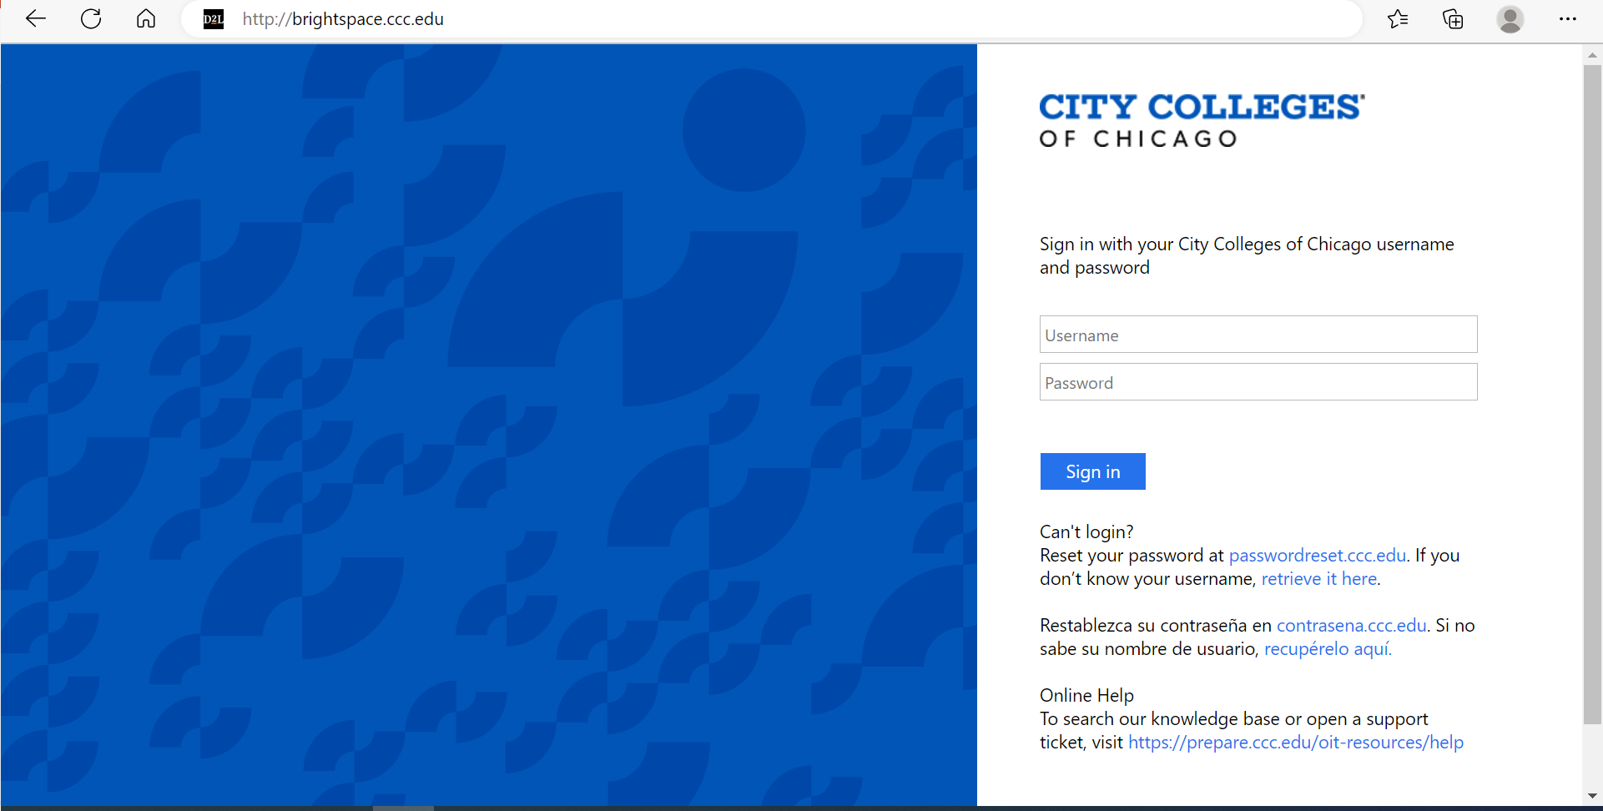
Logging into your Online or Online/Live course
Being Active
Option 2
Go directly to Brightspace, CCC Learning Management System, and enter your ccc username and password
This Photo by Unknown Author is licensed under CC BY-SA-NC

Slide 12
When Do I Log Into My Course?
Being Active
FIRST day of class.
You are required to complete week 1 assignments
You are encouraged to log in at least 3 times a week.
NSW (No Show Withdrawal) and dropped from the class.
  Students registered in online classes will be issued a no-show withdrawal (NSW) if they do not pursue academic activities within the online environment of the course on at least two separate days prior to the statistical (STAT) reporting day of the class (see No-Show Withdrawals (NSW) & Refunds for information about the NSW refund policy).
  Academic activities may include, but are not limited to, the completion of assignments, exams and quizzes or participation in online discussions. Academic activities do not include merely logging onto the course site (or learning management system – LMS, see Learning Management System), or acknowledging that you have read the syllabus.
Failure to show evidence of actively participating in coursework by midterm through discussion forums and turning in assignments, you may receive an ADW (Administrative Withdrawal) and you will be dropped from the class.
This Photo by Unknown Author is licensed under CC BY-SA-NC

Slide 13
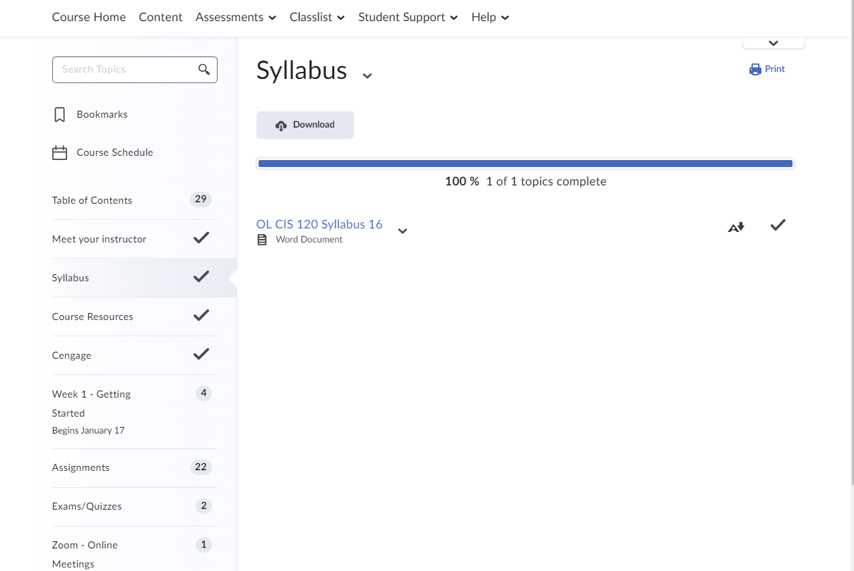
How Do I Participate in
My Online/Online-Live Course?
Being Active
As an Online/Online-Live student you will participate in your course in a variety of ways. The most common are:
Brightspace (Student Learning Management System)
Discussion Boards
Assignments
Group Assignments
Turn-it- in Assignments
Publisher Content (access codes)
Zoom (live online interactive sessions)
  Minimum of 3 sessions will occur in your course
Checking your CCC student email
Proctored and Non-Proctored Exams (No proctored exams on campus until further notice)

Slide 14

Where Do I Purchase Textbooks?
Textbooks
CCC online bookstore-Barnes and Noble
Students who wish to purchase their textbooks from a different bookstore should :
  first visit the CCC online bookstore web site
  IDENTIFY ALL of your course materials, and make sure the authors, editions and ISBN #s are the same.
  Bookstore is usually open two months before the semester begins
NOTE: Financial Aid can be used to buy textbooks from CCC online bookstore.

Slide 15


Who Do I Contact For Support?
Support
Technical support (CCC related)
  Contact 312.553.2600 - Technical Support Website
  Publisher related issues( ex: access codes, account setup, course keys) please contact publisher technical support.
Assignments and course content questions: (ex: missing assignments, directions not clear, navigation problems)
  Contact your instructor via email and/or phone using the phone numbers in the course and syllabus
Instructor issue: (instructor not responding, instructor being rude or not supportive)
  Instructor
  Corresponding department at your home college

Slide 16
Who Do I Contact For Support?
Support
Grade appeal
  Instructor
  Corresponding department at your home college
    Department Chair
  Associate Dean of Instruction
  Dean of Instruction
  Vice President
  For additional support please visit Online Learning at City Colleges of Chicago or
http://ccc.edu/onlinelearning

Slide 17

Student Support Services
Support
CCC Virtual Student Services
  Academic Advising
  Navigate
  Wellness Centers
  Disability Access Centers
  Libraries
  Legal Clinic
  CCC on campus/online tutoring

Slide 18

Navigate
Support
What is navigate?
  Communicate with CCC
  Schedule Your Appointments
  Check Your To-Dos
  Find Your Resources/Services
  Your Personal Calendar
  Answer Questions, Get
  Personalized Support
  Find friends in your classes for studying and support
  See your schedule - classes, appointments, and college events

Slide 19

Navigate
Support
Transfer
Student
Services
Student
Activities
    Advisors
            Faculty & Educators
Tutors
Financial
Aid
Career Planning & Placement
Navigate’s Coordinated Care Network links you to your support team, and connects them to each other

Slide 20



How to access Navigate
Support
1. Go to the App Store or Google Play
2. Look for “Navigate: Student” from
3. Download and install, accept terms
4. Find “City Colleges of Chicago”
5. Log in using your CCC ID and password
6. Complete the short intake questions

Slide 21

Knowledge Check
Support
State a few differences between Online and Online Live courses?
How often should you log into your Online/Online Live course(s)?
What are different ways you can participate in your Online/Online Live course?
Where should you purchase your textbooks?
What student support services are available?
Who do you contact if you have questions regarding your online courses?

