Slide 1
Finance
Travel & Expense Reimbursement
Presentation

Slide 2
Agenda
Overview of Accounts Payable Travel Processes
  Outline of the Travel Authorization and Expense Reimbursement Processes
  Travel Forms
  Travel Expense Job Aids Handout

Slide 3
Policies and General Guidelines
The policies and guidelines apply to employees and non-employees traveling on pre-authorized City Colleges of Chicago (CCC) business
  Individuals incurring expenses on behalf of the District are responsible for complying with all City Colleges travel and reimbursement policies and procedures
The intent of the policy and guidelines are to ensure reimbursement expenses are in compliant with our internal practices, state statutes and federal regulations, be equitable to both the traveler and City Colleges
Please be mindful City Colleges Division Heads at their discretion, may have adopted additional travel and expense reimbursement guidelines to the extent are more restrictive in nature and do not conflict with our policies, local city, state and federal regulatory codes

Slide 4
Continued Policies and General Guidelines
Identified available funding is required for all travel and expense reimbursements, regardless of dollar amount
Prepaid expense requires a vendor number (e.g. 0000012345) this mean the vendor information is already in and/or is updated in the Finance PeopleSoft system such as the vendor name and remittance/payable to address. (e.g. departmental, grants and other funding sources that are not union and/or HR Benefit funded)
  Mid-high average plus (+25%) for the modes-of-transportation listed below does not require additional approval but will be factored in your TA pre-paid request for funds not covered by a collective bargaining agreement (CBA). (e.g. Mode-of-Transportation with 25% overage cap: Airfare=$450; Train=$250; Car rental=$110; bus=$250.)
  Over mid-high average from $563 to $790 requires additional prior approval by the President/Vice Chancellor and/or Designee
  All transactions over $791 to $1,000 require the CFO and/or Deputy CFO/Designee before submitting your T&E request
  Per policy section 1.9.3.a any transactions >$1,001 listed above will require a roll call vote by the Board, if the maximum is exceeded
  All prior authorization via email and/or memo must be included in TA and/or TE requests

Slide 5
Introducing A New Unions Professional Development and
HR Benefits Tuition Workflow
Union Employee Travel/Expense Request
AP Prepay Auditor
HR Business Manager and/or HR AVC
*Union Committee Chairperson
**Supervisor and/or Reviewer
*President
The new online TA approval workflow that includes the Union Committee Chairperson & President begins July 2022
Authorization workflow for all CBA/HR Benefits Employees
Must perform and have Valid Budget Check
Union Travel Expense Reimbursement Application Form
* = Approver responsible for Budget Checking
** = Same as CCC Works 1st Level Approver when applicable

Slide 6
Introducing a New All Employee International Travel Abroad Approval Workflow
The new online TA approvals now includes all the required approvers
Business Purpose: Select International Travel to route your request properly
Employee Travel/Expense Application-Paper
Union Committee Chairperson
(if applicable)
President
**;* College VP of Finance/DO Business Manage
*DO Chief Financial Officer
AP Prepay Auditor
Risk
Management
Application -Paper
Paper OSM FORM
Must perform and have Valid Budget Check
Provost or Chancellor
Paper Application must be completed by Risk Management Dept
* = Approver responsible for Budget Checking
** = Same as CCC Works 1st Level Approver?
This project is scheduled to begin July 2022

Slide 7
Information You Need to Know Prior to Creating a Travel Authorization (TA) Request
For Union faculty and staff, Expenses require a paper application form only to be attached to your online TA and/or TE request
  To obtain form(s) please click the link: AP Forms
  Strongly recommended to read the travel policies and the union contracts to understand its provisions
  Click the links to view contracts and the travel policy: Union Contracts-CBA and Travel Policy
  The Illinois Department of Labor (IDOL) law for Employer Reimbursement for Employee Expenses Public Act (PA) 100-1094 (SB2999) has been effective since January 1, 2019, mandates an employee required to submit expense for reimbursement within 30 days of parameters of employer reimbursement policy
  If your request is not submitted timely it will not be considered or you will no longer be eligible to attend an event, make a purchase and/or obtain an expense reimbursement

Slide 8
Continued Information You Need to Know Prior to Creating a Travel Authorization (TA) Request
  Include all documentation to support your request such as conference agenda/itinerary, registration form with fees and remittance/pay to information
  Please submit your request at least 30 days prior to an event or purchase
    TA requests cannot be back dated it must have a current or a future date
  Please be aware of the availability of funds, which are limited and available on first come first served basis each/per fiscal year
  Reimbursement allowances chart is on the next page for Unions Professional Development and HR Benefit

Slide 9
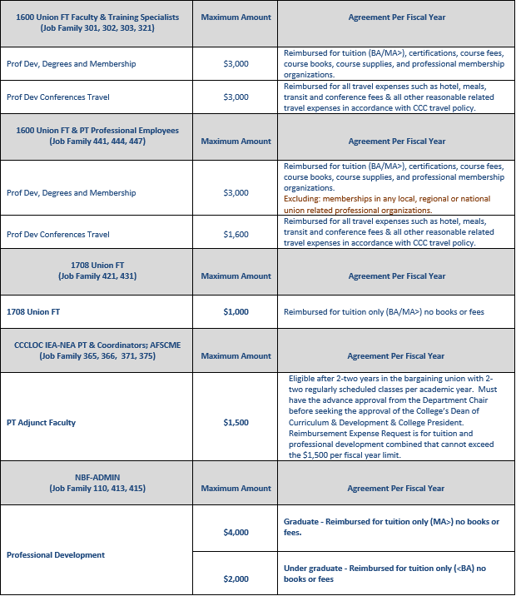
Continued Information You Need to Know Prior to Creating a Travel Authorization (TA) Request
Diagram link:
CBA-HR Benefits Allowance Chart

Slide 10
Continued Information You Need to Know Prior to Creating a Travel Authorization (TA) Request
Tuition Related Expenses
  Employee must complete a tuition application form with all required approval(s) that include support documentation such as course description, class schedule with the start and end dates and cost/fee
  Online electronic Travel Authorization request with attachments are required to be in the HR AVC queue no later than 30 days after class begins or according to the Unions CBA contract
  Travel Reimbursement Expense (TE) require grade report and proof of payment that must be submitted and in the HR AVC queue no later than 30 days after the last day of class
  District Office Union 1708 and 1600 Professional Development requests are routed to and approved by HW President

Slide 11
Continued Information You Need to Know Prior to Creating a Travel Authorization (TA) Request
Per IRS rules for tuition if any employee exceeds $5250 per calendar year it will become imputed taxable income
  This means the amount that exceeded the $5250 is imputed as taxable income (only federal & state taxes are calculated on the overage amount and not your gross amount)
  The overage amount is included in the employee’s last payroll calendar check (PPE 26) of the year. (Payroll code TRT – Description; Tuition Taxable > 5250)
Any tuition that’s submitted after December 16th or the first pay period date in December will be reviewed and approved by AP but payment reimbursement will not be released until after January 1st
Please be mindful your submission, approvals and payment disbursements are all about timing, which may affect you at the end of CCC HR Payroll calendar year

Slide 12
Home Campus Business Services Office (BSO)
Contact Information
Home Campus | Email address
Kennedy King | kkc-ap@ccc.edu
Harold Washington | hwc-ap@ccc.edu
Malcolm X | mxc-ap@ccc.edu
Harry S Truman | trc-busoffice@ccc.edu
Olive Harvey | boinvoices@ccc.edu
Richard J Daley | dac-accountspayable@ccc.edu
Wilbur Wright | wwcbusinessoffice@ccc.edu
Please be mindful your first point of contact is always your campus BSO when you need assistance. Link to diagram Home Campus BSO Email Contacts

Slide 13
District Office Business Services Managers (BSM)
Contact Information
DO Home Office | Email address
Academic Student Affairs (ASA) | asabusinessoffice@ccc.edu
Office of Information Technology (OIT/IT) | oitbusinessoffice@ccc.edu
Finance Accounts Payable Administrative Services & Facilities Procurement Services Student Financials Financial Reporting General Accounting Grant Accounting Budgeting | mwilliams218@ccc.edu accountpayableservices@ccc.edu dtaylor294@ccc.edu procurementservices@ccc.edu kperduesmith@ccc.edu bgename@ccc.edu & cfitzpatrick1@ccc.edu tjeter3@ccc.edu cccbudget@ccc.edu & mgeng@ccc.edu
DO Home Office | Email address
Office of Institutional Advancement (OIA) Community Relations Development Enrollment Management Marketing & Communications | scartledge@ccc.edu
General Counsel (GC) | gencounseloffice@ccc.edu
Human Resources (HR) | sbeamon5@ccc.edu benefits@ccc.edu
Chancellor’s Office | glaralarimore@ccc.edu
Link to diagram
DO Dept Email Contacts

Slide 14
Travel Allowance Expense Reimbursement Feature
Expense Type Setup for Maximum Reimbursement Allowance
  This feature will calculate the employee expenses and maintain the allowable balances that are due and remaining
  This feature won’t allow the requestor to exceed the maximum allowance amount
  The Expense Type for each Union/HR Benefit must be selected in order for the calculations to work properly
  The charge of accounts have been defaulted for these new expense types
    This allows a travel request to be routed properly for review and approval
    The defaults will eliminate incorrect approval routing, send backs and resubmissions

Slide 15
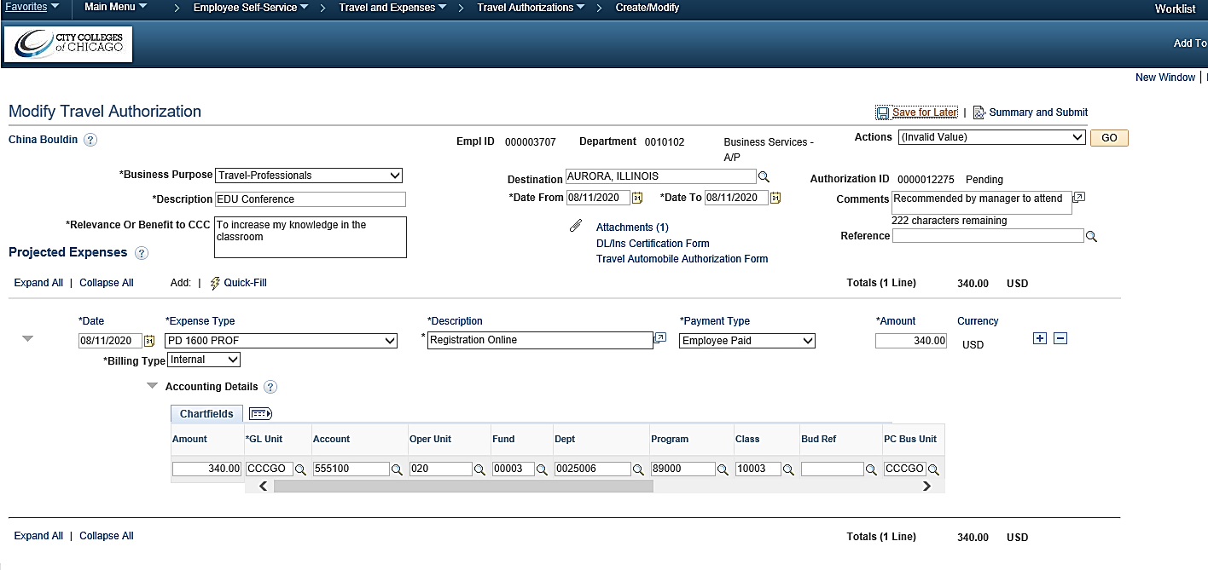
Continued Travel Allowance Reimbursement Expense Feature
This is a example of a TA request before submission

Slide 16
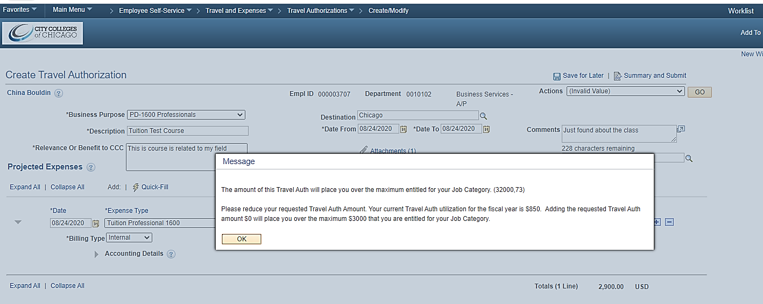
Continued Travel Allowance Reimbursement Expense Feature
A message will appear informing if a request exceeds the maximum allowance for an entitled job category

Slide 17
TA Estimated Expenses/Quotes Required: | Yes | No | Comments:
Official Announcement: Agenda or Invitation to conference, seminar, training, meeting (internal or external) |  |  | Required on all TA
Registration Fee |  |  | When applicable; If yes makes sure the form is filled out completely. The vendor’s payable to and remittance address are part of your support backup and/or in the PS vendor dbase system
Common Carrier Name |  |  | When applicable; Required
Flight/Train Cost |  |  | When applicable; (avg. $450)
Auto Travel (Requires annual Travel Mileage Driver License and Insurance Agreement) |  |  | When applicable; required annually per fiscal year (>July 1st)
Car Rental |  |  | Approved as exception- must provide detailed explanation demonstrating rental is cheapest mode of travel
Lodging |  |  | When applicable; govern by GSA rates
Anticipated Parking Expenses |  |  | When applicable; $25 per segment
Meals Allowance (GSA) |  |  | When applicable; govern by GSA rates; 1st & last day is 75% of maximum meal allowance
Miscellaneous Expenses (i.e. shuttle, taxi, tolls, etc.) |  |  | When applicable;
Membership fees (Require Membership Authorization Form) |  |  | When applicable; requires the Professional Membership Form
Relevance to Position |  |  | When applicable
Late Explanation required for 30 days & greater submissions |  |  | When applicable; required past the 16Th day & greater.
Non-Purchase Order related expense request pertaining to instructional supplies only (i.e. Hearts) |  |  | Relevant expense quotes
Travel
Authorization
Report
Detailed
Check
List
Link to diagram: TA Check List

Slide 18
TE Actual Travel Expenses/Receipts: | Yes | No | Comments:
Travel Expense Summary Cover Page |  |  | Required with all TE Expenses that are not itemized by day
Link Approved Travel Authorization Number (i.e., transaction id # 5012) |  |  | Required with all approved TA
Registration Confirmation (proof of payment) |  |  | When applicable; required form of payment method & a zero balance
Actual Carrier Name |  |  | When applicable; Name required
Actual Flight/Train or other mode transportation cost (Boarding Pass or receipt from Concur) |  |  | Required with all Airfare Purchases
Car rental |  |  | When applicable
Parking |  |  | When applicable
Lodging (itemized by day) |  |  | When applicable
MapQuest/Google Maps (exclude campus-to-campus) |  |  | When applicable
Meal Allowances (detailed itemized receipt by day) |  |  | When applicable; GSA rate for 1st & last day is 75% of maximum allowance
Membership fees |  |  | When applicable
Miscellaneous Expenses (i.e. shuttle, taxi, tolls, etc.) |  |  | When applicable
Proof of Conference Attendance & Synopsis (i.e. badge, agenda) |  |  | When applicable
Special Note: All Travel Expense Report requests must be submitted within 15 days from your last day of travel or purchase. |  |  | Per the Travel Reimbursement Expense policy
Travel
Expense
Reimbursement
Report
Detailed
Check
List
Link to diagram: TE Check List

Slide 19
Travel Expense Reimbursement Requirement Documents – Job Aid
Education Required Documents;
1 | Course start & end date
2 | Course description
3 | Account statement showing cost of tuition per course
4 | Tuition application
5 | *if applicable* cost of books and supplies ONLY for Local 1600 Union Members
Professional Membership Required Documents;
1 | For Union and Non-Union - Professional Membership Request form Prof Dev Membership Form Union requests - this is the only form needed to make a purchase because it substitutes as your TA Please attach this form and your proof of payment to your TE when seeking expense reimbursement
Prepaids- only non-union funded request requires the payable to and the remittance addresses to be in or added/updated in the PeopleSoft (PS) Systems vendor dbase
If membership fees are associated with a conference cost the Professional Membership Request form is required
2 | Invoice and or supporting documentation must include membership cost, payable to, and remittance address
Travel/Conference Required Documents;
1 | Registration cost
If registration is prepaid an Invoice or completed registration form with payable to and/or remittance address is required and added/updated in the PS vendor dbase
2 | Conference schedule and/or announcement that indicates the time, date(s) and place of conference
3 | Quotes for transportation (airfare, bus, train, taxi, ride share etc.)
4 | Agency fee - $23 via phone and $8 via self-booking
5 | Hotel quotes for lodging - GSA standard rates apply
6 | Meal expenses - Per diem quoted from GSA standard rates
7 | Travel & Expense Links GSA.GOV; Intranet SharePoint page;
Off-Site Meeting Requirements;
1 | If travel is within 50 miles inter-city a TA is not required. However, the following documents below are needed for a TE;
2 | Meeting announcement - email calendar invite and agenda
3 | Mileage - map quest
4 | Receipts for parking (up to $25 per segment in/out)
5 | Map Quest: http://www.mapquest.com/ Auto Insurance Certification Form: Auto Ins Certification Form.pdf Auto Mileage Authorization Form: Auto Mileage Authorization Form.pdf
Travel
Reimbursement
Expense
Report
Summarized
Requirements
List

Slide 20
Continued Travel Expense Reimbursement Requirement Documents – Job Aid
International/Foreign Travel Abroad Required Documents;
1 | Must complete the Travel Abroad – Office of Risk Management Consultation Form that is reviewed, vetted and approved by the ORM Department, before adding it to your online TA request ORM Travel Abroad Form
2 | Narrative as to Purpose of Travel & Destination
3 | Dates of Conference, Seminar, Sabbatical or Other Purpose
4 | Travel Itinerary (inclusive of Flight information & Ground transportation)
5 | Lodging Accommodations at Destination (include Address & Telephone)
6 | Travel Budget & Source of Funding
7 | The completed Travel Abroad – Office of Risk Management Consultation Form (ORM) It is strongly recommended to submit this request at least 60 days prior to the date of expected event If you do not have required approval prior to attending an event you will forfeit your travel expenses Effective July 1st – CCC ORM Travel Abroad Form ORM Travel Abroad Form Foreign Travel aoprals.state.gov. Currency Converter http://www.oanda.com/currency/converter/
Special Notes;
1 | Please be mindful City Colleges Division Heads at their discretion, may have adopted additional travel and expense reimbursement guidelines to the extent are more restrictive in nature and do not conflict with our policies, local city, state and federal regulatory codes
2 | It is strongly recommended for Travelers to submit their requests at least 30 to 60 days prior to an event or purchase. This will allow request to be processed proficiently and resolve any issues that may arise timely
3 | If a Traveler do not have all required approvals prior to attending an event or purchase, per CCC Policy and CBA contract means their expenses will be forfeited and their TA request will be denied
Travel
Reimbursement
Expense Report
Summarized
Requirements
List

Slide 21
Travel and Expense Review Process
  Business Services Office/District Departments
Review, verify and approve Travel and Expense Reimbursement Requests before processing or submitting to A/P for payment processing
  Please do not create a TE expense report if you do not have a prior approved TA request. Per policy all expenses requires prior approval except for mileage and membership requests
    Mileage – this means that your immediate supervisor/manager knows your whereabouts
    Membership – union members required the union application forms & non- union members require the professional development form (PDF)
    If you have an approved TA please do not type in any TE fields, must copy TA request from the quick start dropdown into the TE report in order to avoid system issues.
  Verify timely submission of reimbursement request (within 15 day from last day of travel or purchase); only one exception to the 15 day requirement will be allowed
  Verify that all proper forms/documentation and reasons for travel or purchase
  Verify mathematical accuracy
  Verify scanned detailed itemized receipts with proof of payment
  Verify expense account(s) associated with all cash advances and determine if any funds should be returned from the cash advance received
  Verify if all expenditures (i.e., travel and/or purchases) that require pre-approval signatures have been obtained
  Verify proper allocation of expense(s) are according to budget procedures and charge to accurate charge of accounts
Please be advised it is the responsibility of the Supervisor or Manager (first-line Approver) to ensure that an Employee's Expense Reimbursement Form requests is complete and that adequate documentation has been provided to substantiate the expense
The Reimbursement Expense requests will be returned to the Employee if not completed, as noted in the policy
Notes:
This slide is so important for all en-users departments to follow before submitting invoices or reimbursement requests to your managers or business offices for approval.
If all the steps are followed your request will or should be routed for approval timely.

Slide 22
All Travel & Reimbursement Expenses
Canceled checks or Credit Card Statements
  Is only required if the form of payment method is not listed on receipt and/or have a balance due.
  The front and back of the canceled check or credit card statement, together with a bill from a payee, ordinarily establishes cost
    However, a canceled check or a credit card statement by itself does not prove a business expense without other evidence to show that it was for a business purpose
Missing Receipts and supporting documentation
  Affidavits must accompany a written explanation and signed by the employee stating the reason the original is unavailable
  There is a limit of 1 per fiscal year
Travel & Expense Reimbursement Policy Agreement
  The annual Employee Reimbursement Acknowledgement Agreement must be completed on-line at the beginning of each Fiscal Year July 1st
  The annual Travel Automobile Authorization Form and DL/Ins Certification Form must be completed and sent to AP each Fiscal Year July 1st. Please note these form links are located on the Create/Modify Travel Authorization page as well as on the Intranet SharePoint

Slide 23
A/P Travel Matrix
Diagram link: Travel Matrix
23

Slide 24

Accounts Payable Services Personnel
Desire Richardson
A/P Control Analyst II
TR, & Travel and Reimbursement Expenses
(773) 487-6989; x-46989
Email: drichardson110@ccc.edu
Antoine Lewis
A/P Control Analyst I
HWC, OHC, RJDC, WRC, & Foundation
(773) 487-1677; x-41677
Email: alewis48@ccc.edu
Tiffany Harrison
A/P Control Analyst I
Barnes & Noble and AP Projects
(773) 487-3613; x-43613
Email: tharrison@ccc.edu
China Bouldin
A/P Manager
(312) 553-2819; x-12819
or x-43718
Email: cbouldin@ccc.edu
Jacqualyn Jones
A/P Supervisor
DO, Travel & Reimbursement Expenses
(312) 553-2814; x-12814
Email: jjones689@ccc.edu
Debbie Nesbitt-Mohammed
A/P Control Analyst II
KKC, MXC & Assist with Travel and Reimbursement Expenses
(773) 487-3734; x-43734 Email: dnesbitt-mohammed@ccc.edu

Slide 25
Questions

