Slide 1
General Education Assessment
Professor Benita Hunter,
Professor Tabatha Robinson
Dr. Keith M. McCoy, Vice President
August 13, 2015

Slide 2
Assessment
Overview
Assessment Plan
Fa14 & Sp15
Assessment
Actions to be Taken
Fall 2015 Pilot Assessment

Slide 3
Assessment
Process by which we measure student achievement of learning outcomes or attainment of aptitude.

Slide 4
Assessment
Assessment can…
Answer questions about the learning of individual students
Be used to determine the effectiveness of a single course, program, or institution
Association of American Colleges and University. (2005). Levels of Assessment: From the Student to the Institution.

Slide 5
Assessment
Overview
Assessment Plan
Fa14 & Sp15
Assessment
Actions to be Taken
Fall 2015 Pilot Assessment

Slide 6
General Education Outcomes
Communicate using Standard American English.
Evaluate the moral, ideological, or intellectual viewpoints of diverse peoples or institutions. (Human Diversity Outcome)
Prepare a document using digital technologies, such as a word processor, spreadsheet, or presentation display software (e.g. PowerPoint).
Evaluate a proposed solution to a local, national, or global issue.
Produce an original piece of work demonstrating creativity.
Developed October 2011

Slide 7
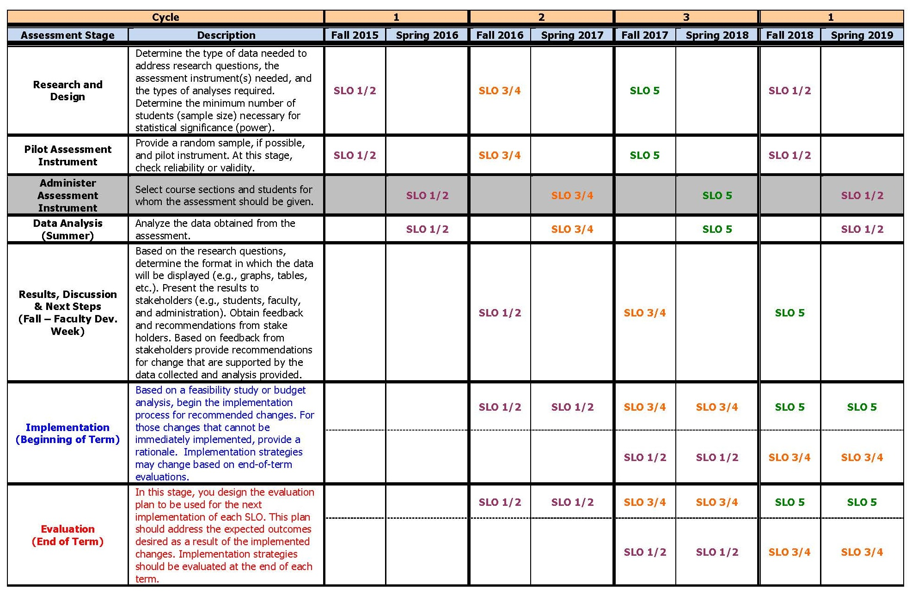
Daley Program Assessment Plan

Slide 8
Assessment
Overview
Assessment Plan
Fa14 & Sp15
Assessment
Actions to be Taken
Fall 2015 Pilot Assessment

Slide 9
Fa14 & Sp15 Program Assessment
Assessed:
  Produce an original piece of work demonstrating creativity.

Slide 10
Fa14 & Sp15 Assessment Characteristics
Administered
Fall 2014: Wednesday & Thursday, November 19 & 20, 2014
Spring 2015: Monday - Thursday, April 13 – April 16, 2015
  During Assessment Week
  Students completing assessment promised a free transcript
  Professor Hunter & Robinson proctored assessment for approximately 3-4 hours each day
  Students were assessed in 1105 and were provided with lunch
Sample: (1) Convenience Sample, (2) Potential Fall 2014/Spring 2015 Graduates, (3) Varying Associate Degree Completers, and (4) N=12 (Fall 2014) & N=6* (Spring 2015).
*One student’s presentation was thrown out, due to plagiarism.

Slide 11
Fa14 & Sp15 Assessment Instrument
Housed in Blackboard Shell
Administered using a written prompt
Asked questions to elicit responses that could be used to measure student achievement of program outcomes (SLO 5)
Used a rubric (checklist) to evaluate student responses.

Slide 12
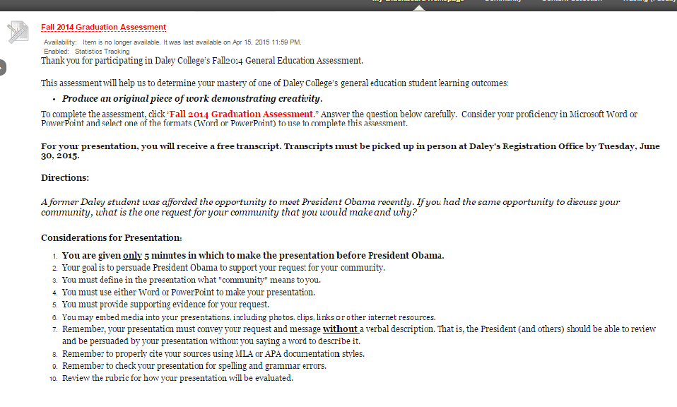
Fa14 & Sp15 Assessment Instrument

Slide 13
Fa14 & Sp15 Assessment Rubric – SLO 5
Communication
Did the student use Word or PowerPoint to effectively make their request?.
Was the student’s request clear?
Did the student explain the importance or relevance of his/her request?
Did grammar or other writing errors interfere with the communication of the request?*
  *Item revised for spring 2015.
Persuasiveness
Is the presentation convincing?
Did the student provide supporting evidence for their request?
YES
NO
YES
NO
YES
NO
YES
NO
YES
NO
YES
NO

Slide 14
Fa14 & Sp15 Assessment Rubric – SLO 5
Innovation
Does the work generate ideas that are not typical or expected?
Did the student put together visuals or words in new or surprising ways?
Is the content of the presentation engaging?
Does the content stimulate further thought or discussion?
YES
NO
YES
NO
YES
NO
YES
NO

Slide 15
Fa14 & Sp15 Assessment Rubric Evaluation
Benchmark: 75% Achieve Task
Criteria | Present | Absent
Did the student use Word or PowerPoint to effectively make their request? | 35% | 65%
Was the student’s request clear? | 47% | 53%
Did the student explain the importance or relevance of his/her request? | 47% | 53%
Did grammar or other writing errors interfere with the communication of the request?* | 47% | 53%
*Item revised for spring 2015.
Is the presentation convincing? | 71% | 29%
Did the student provide supporting evidence for their request? | 24% | 76%
Does the work generate ideas that are not typical or expected? | 24% | 76%
Did the student put together visuals or words in new or surprising ways? | 18% | 82%
Is the content of the presentation engaging? | 29% | 71%
Does the content stimulate further thought or discussion? | 41% | 59%

Slide 16
Fall 2014 & Spring 2015 Assessment
Student Examples
Example 1 (Fall 2014)
Example 2 (Spring 2015)

Slide 17
Discuss Actions to be taken for SLO 5

Slide 18
Assessment
Overview
Assessment Plan
Fa14 & Sp15
Assessment
Actions to be Taken
Fall 2015 Pilot Assessment

Slide 19
Departmental Strategies
Review Departmental Outcomes
  Align Outcomes to Daley’s five Gen. Ed. Outcomes (State how the alignment works)
  Develop Departmental strategy(ies) to develop student learning relative to departmental outcomes (Action Plans)
Report Out & Receive Peer Feedback
  Edit or revise based on feedback, if necessary
Submit Action Plans

Slide 20
Next Steps
Devise Evaluation Plan for Fa12-Sp13 Intervention
  Grammar was an Issue
  Updated DEI activities (Intervention)
  Expect improvement for Fa15-Sp16 graduates
Provide Follow-up Mechanisms for Implemented Interventions or Strategies
Craft a Professional Development Plan for Faculty around Strategies to meet Intervention Goals

Slide 21
Assessment
Overview
Assessment Plan
Fa14 & Sp15
Assessment
Actions to be Taken
Fall 2015 Pilot Assessment

Slide 22
Fall 2015 Pilot Assessment
Assess student learning outcomes 1 & 2:
  Communicate using Standard American English.
  Evaluate the moral, ideological, or intellectual viewpoints of diverse peoples or institutions. (Human Diversity Outcome)

Slide 23
Fall 2015 Pilot Assessment
Determine the type of data needed to address the SLO(s).
Identify the assessment instrument(s) needed, and the types of analyses required.
Pilot assessment(s) during Fall 2015.

Slide 24
Fall 2015 Pilot Assessment
Assessment linked to fall degree completers.
  Assessment week: November 9 - 12
Assessment/Evaluation committee meetings first Wednesday of each month at 3:30pm.
  Volunteers sought for two-hour commitment
  Includes program reviews
  Continue develop of program outcomes (academic and non-academic).

Slide 25

THANK YOU
Daley on the move!

Slide 26
Student Example 1

Slide 27
Safer Community

Slide 28


Community

Slide 29
Crime
Having a safer community means being able to enjoy family more
Being happy and not worrying about getting hurt
A community is the second family to share happy moments and get support
Crime reports in Gage Park
March 11 - April 10, 2015¹
17reports
Robbery - 7
Battery - 2
Assault - 6
Homicide - 0
Sexual assault - 2
Notes:
http://crime.chicagotribune.com/chicago/community/gage-park

Slide 30
Gage park Community
property crimes
42
reports
Theft - 32
Burglary - 3
Motor vehicle theft - 7
Arson - 0
quality-of-life crimes
31
reports
Criminal damage - 12
Narcotics - 19
Prostitution - 0
Notes:
http://crime.chicagotribune.com/chicago/community/gage-park

Slide 31

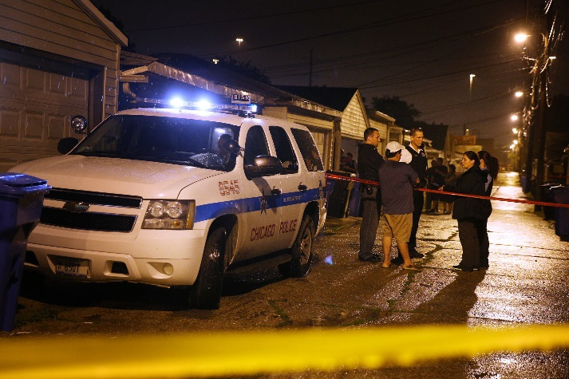

Bad Crime
Return to Student Examples

Slide 32
Student Example 2

Slide 33

Community means a sense of belonging and feeling valued

Slide 34
Many Residents of the Brasilandia slum in Sao Paulo Brazil do not have access to piped water!

Slide 35
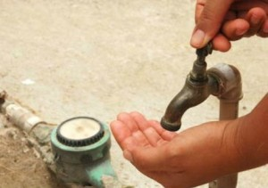

Slide 36
Due to flooding residents lose their homes and go to live on the streets.

Slide 37
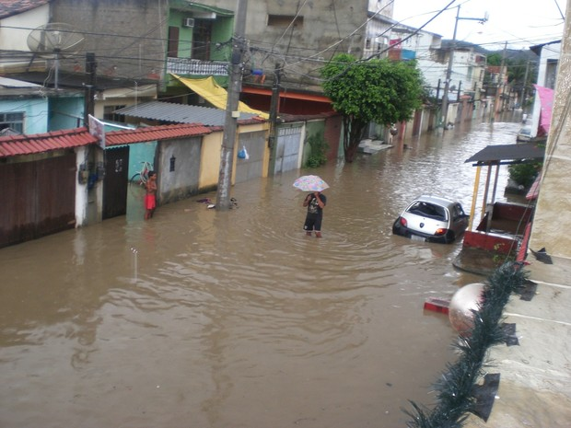
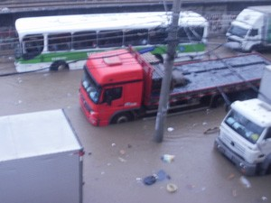
These families do not have anywhere to go and many are unemployed!

Slide 38
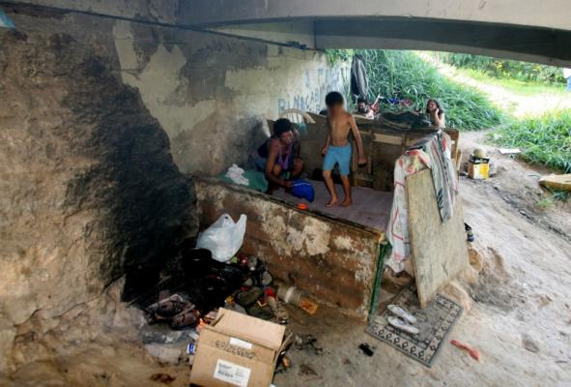
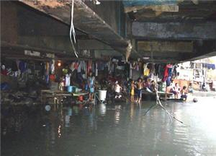
Is very sad to see the situation of those families with children living in the streets under bridges
Help Please!!!!
Help Please!!!

Slide 39
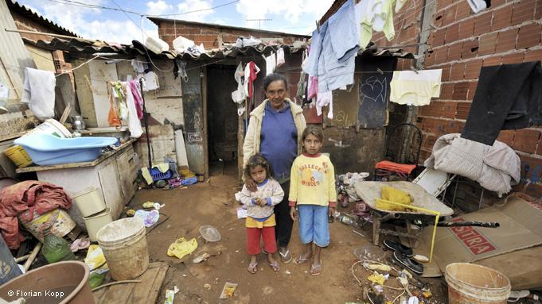

Slide 40
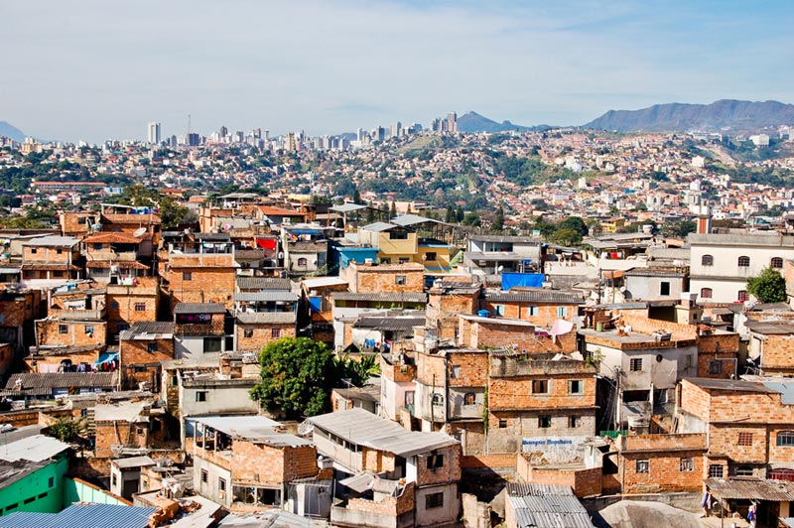

Slide 41
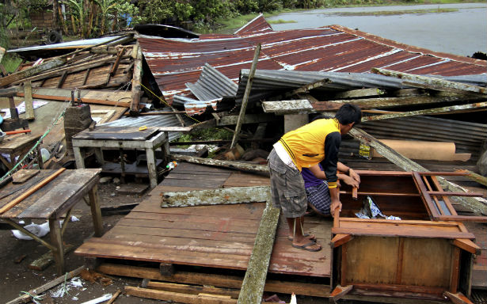

Slide 42
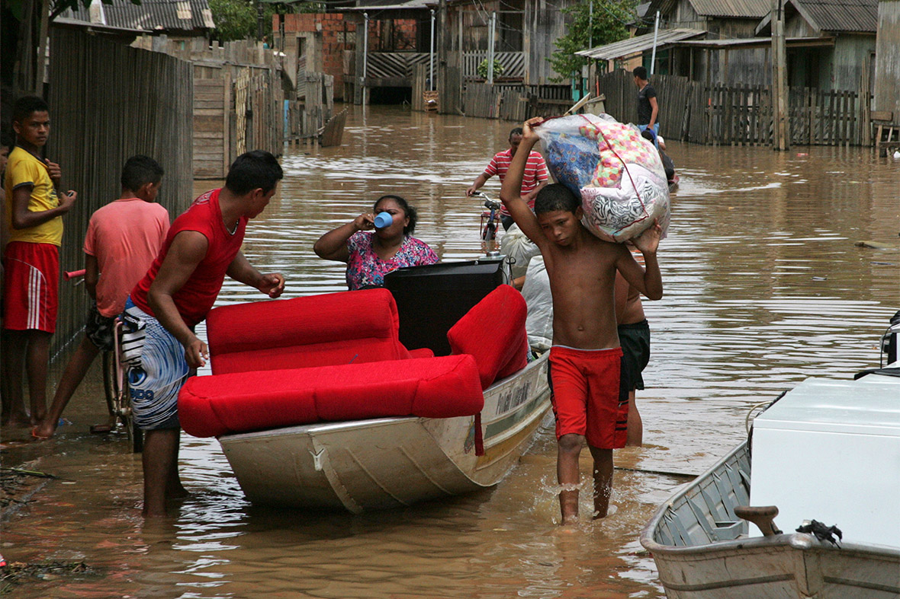

Slide 43
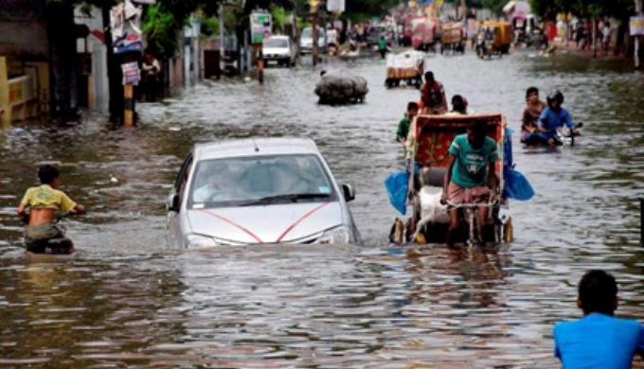

Slide 44
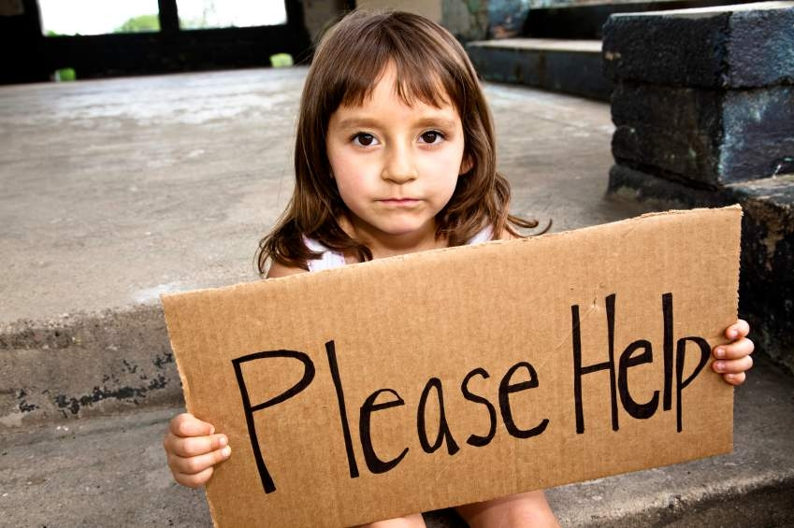

Slide 45
References:
"Hundreds of Deaths in Brazil, a Product of Negligence." Human Rights Now. N.p., n.d. Web. 19 Nov. 2014.
"Maristely's Story: A Flower in the Favelas." RSS. N.p., n.d. Web. 19 Nov. 2014.
Return to Student Examples

